Slide 1
Presentations My Approach
June 12th 2014

Slide 2
Structure
Section 1 – General Issues
PP Presentations – How I Normally Prepare and Approach Clients
Section 2 – An Example I like and got the client to think I think
An Introduction to Creditinfo
Problem definition
Value Proposition
On-line demonstration
Take Away – Determine Next Steps (most important part)

Slide 3
PP – Things I keep in Mind
Power Point Presentations are Extremely Boring

Slide 4
PP – Things I keep in Mind
They need to describe the benefits for the client and managers
How will what I have to offer make them look good

Slide 5
PP – Things I keep in Mind
Study the potential client I’m meeting
Web Site
Try and find something positive about the company
Who am I meeting – Credit Risk Managers – Sales – Account Management – CEO etc.
Study their background if possible – If they have achieved something I will mention it
Industry specifics – Is the number of defaults increasing – Are there positive signs in the economy and a potential to sell more
Similar successful projects and business cases worth mentioning

Slide 6
PP – Things I keep in Mind
One Size Normally Does Not Fit All – A General Creditinfo Presentation Should Not Exist
Background Information about myself – try and give them the impression that I know what I’m talking about
Focus on telling a story with a beginning and a happy ending

Slide 7
PP – Things I keep in Mind
Deliver one message – not covering 15 different topics
Pause the presentation and discuss, use examples etc.
Try not to read directly from the presentation
Divide the presentation into chapters – according to the agenda
Keep the number of slides to a minimum

Slide 8
PP – Things I keep in Mind
Bullet points – no need to have long sentences
Add graphics that have some meaning
The audience will often not have a clue what we are doing – “avoid industry lingo”
The major challenge is to keep everyone’s attention
Stick to the timeframe
Look professional and stay out of trouble

Slide 9
Presentation Example
Convince A Potential Client (bank) to Subscribe to our Services

Slide 10
An Introduction to Creditinfo

Slide 11
What does Creditinfo do?
We collect, process and redistribute data, converting it into information and intelligence, mainly for the use of optimizing credit processes:
An universal name for entities providing similar services does not exist, the most used designations though being; credit bureaus, credit reference companies, credit information companies, credit registries (usually state owned)
Central to our operations is always credit related data, such as credit histories and information on debts that have been defaulted on.
We also try to add in each market all other information that can be processed (legal-, technical- and practical-considerations taken) and can support said purpose
Information (processed data) is sold to interested parties, mainly credit providers, depending on local legislation.

Slide 12
An Introduction to Creditinfo
Use our International Experience, Size, Know-How and Capabilities to our advantage – Beef Up Our Local Profile
Focus on complete solutions in risk management
Providing scoring, decision engines, pricing modules, etc.
Fraud prevention, work flow-, collection-software and other credit tools
Consulting on credit processes, risk management, seminars
Endorsed by Internationally-recognized Authorities and Organizations:
Long-term relationship with the World Bank and International Financial Corporation, Central banks and Banking associations in different countries
Currently operating 16 subsidiaries / affiliates in 14 countries, approx. 250 employees
4.000 satisfied and loyal clients worldwide
More than 600 Banks, Credit Unions and other financial institutions
Clients from all sectors (Telco, Construction, Insurance, Legal, Leasing, Debt Collection, Automotive, Utilities, Pharmaceutical, Wholesale etc).
Long customer lifecycle – Clients stay with us for many years

Slide 13
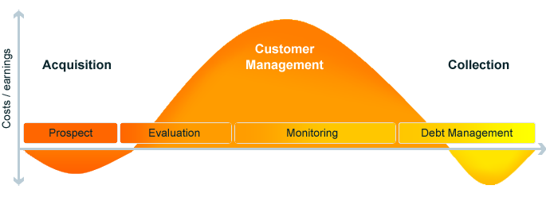
How we help in the Business and Consumer Environment
Notes:
Óþarfa glæra?

Slide 14


An Introduction to Creditinfo
Find relevant / related projects – business cases – products etc.
Demonstrate that we have done it all before and been successful in doing so
Endorsement letters from customers from the same or similar industry sectors
“The Creditinfo Solutions Company implemented an automated system for evaluating Loan Applications and Applications for Vehicle Leasing in the UniCredit Leasing Company. The implementation of the system was executed professionally and it brought ordinal increase in the capacity for approving applications.”
“We decided to use Application Processing not only thanks to its quality but also because it provides us with various connections to external sources. These sources then help to significantly simplify the conclusion of any contract without the necessity to check data offline.”
“The Creditinfo Solutions Company has executed the implementation, operation and subsequent maintenance of the Application Processing Solution thoroughly and professionally. We can confirm our satisfaction with the cooperation on behalf of the VB Leasing Company.”

Slide 15
Problem definition

Slide 16
Problem Definition
So why are we here?
What’s the problem?
How is it affecting your business?
Ask questions and understand current conditions –
% of NPL
Application Processing,
Workflow in terms of Risk Management
Number of new applications
Contracts Terms and Conditions (Do we need to suggest changes)
Etc.

Slide 17
Problem Definition
Tanzania Example
A potential Client (bank) not using our services

Slide 18
Tanzania Example
Over 20k Searches are made per month in the DataBase
5k credit reports taken last month.
Some banks are already avoiding the 137,044 customers with a bad payment history and forcing them to go to other banks.
This means that someone is picking up the bad customers

Slide 19
Bad Customers
The Number of Contracts Past Due are increasing as the database grows
These Applications are being rejected by active CB users
Unfortunately they are being accepted by others (Your Bank Mr. Risk Manager)
Is it normal to give a loan to someone who already has another loan that is 60 or more Days Past Due? (No - Well You Are !)

Slide 20
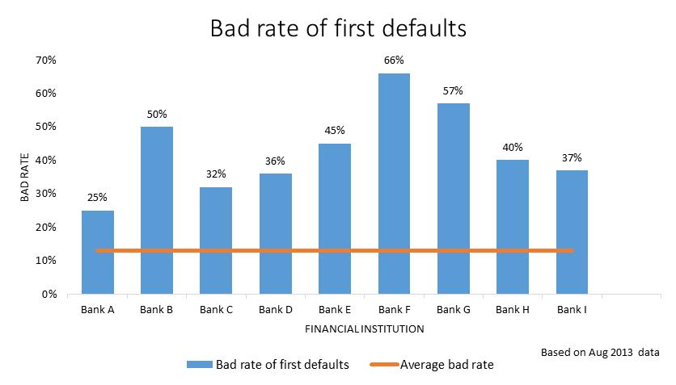
Problem Definition
Let’s look at the 9 largest banks in Tanzania and loans granted in August 2013
The average and normal default rate is expected to be around 15%
In August 2013 there was a large population that already had negative payment remarks in CB database (137k)
Many of the banks appeared to accept this segment
So what happened?
The default rate for this group of customers is substantially higher than the industry average

Slide 21
Customers Using are Have Lower Bad Rates
Let’s look at Bank G for example
Out of 1000 applications accepted in August the CB had information about 100 that already had payment incidence but where accepted
57% of them our now in default and will probably be written off
This is substantially higher than the 15% industry average
We wouldn’t be surprised if this number would grow as is the reality with Bank F
Knowing this
-Would you still lend these 57 customers?

Slide 22
Rejected Customers
The data is telling us something we already know
What do customers do after rejection?

Slide 23
Rejected Customers
They often apply for loans from different financial institutions!
Is your bank able to reject these “bad” clients, which come from other banks?
Notes:
Wheter or not your bank is rejecting these clients and accepting

Slide 24
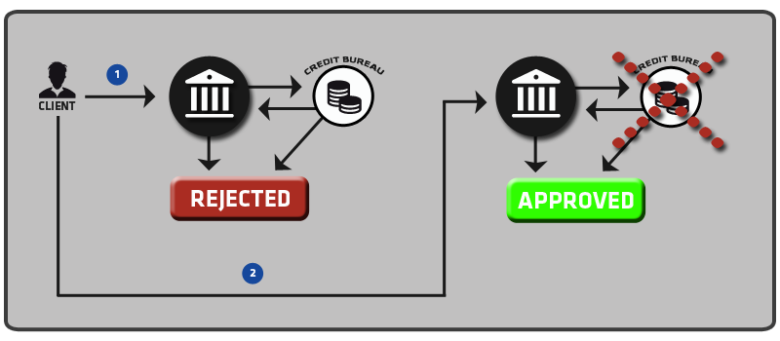
Is your bank able to reject these “bad” customers?
Competitor (A)
Bank (B)
Result:
Current past due amount of 1,736,160 TZS
Notes:
Consider this real life example taken from Cb database…
CB info is utilized by a competitor, which leads to rejection… how
ever,…
ABC rejected the client based on the CB but Equity accepted, they issued a report and agreed
ABC they made a request in CB information client had negative remarks,
Report was issued we could see negative payment information, assume that was the case

Slide 25
Is your bank able to reject these “bad” customers?
Competitor (C)
Bank (D)
Result:
Current past due amount of 4,005,805 TZS and number of past due days equals to 81
Notes:
Date of EFC was issued before accepted by Equity, starting date
INST-3001500000795 2013-11-15
INST-3001500000795 2012-09-07

Slide 26
Value Proposition

Slide 27
Value Proposition
How can we help?
And create Value from Data

Slide 28
Negative Information Report
Quick access to negative payment information (About The 140K BAD CUSTOMERS)

Slide 29
How they have been able to Improve
New opportunities will arise from the usage of credit bureau data.
Customers with proven payment histories might be offered better conditions, higher total loan amounts, etc. ,
-which suggests that positive information is at least as important as the negative.

Slide 30
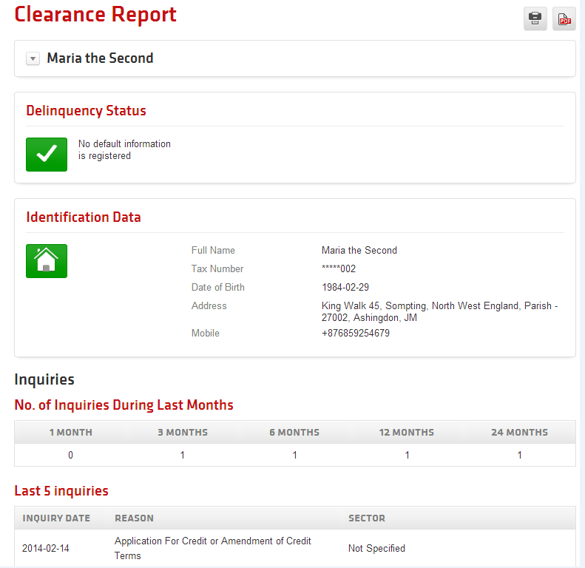
Negative Information Report
Our negative information definitation are contracts which have 30+ days due

Slide 31
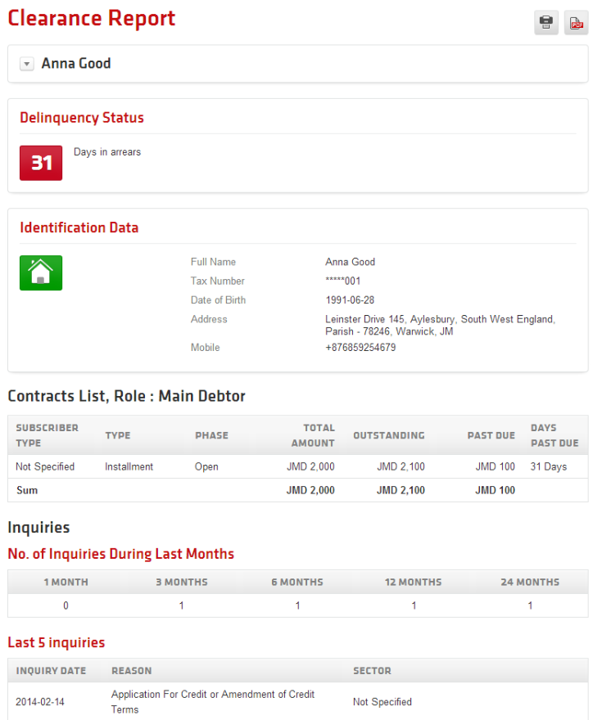
Negative Information Report

Slide 32
Full information sharing improves credit granting
Bank Assessments of the Impact of Credit Registries
70
60
50
40
% respondent banks
30
20
10
0
Decrease in
processing time
Decrease in
costs
Decrease in
defaults
Change
No change
Source: Doing Business, based on World Bank surveys of banks in 34 countries.

Slide 33
Small firms benefit from credit bureaus
Estimates based on data on 5000 firms in 51 countries
% of Small Firms Reporting
High Financing Constraints
Probability of Obtaining a Bank Loan for a
Small Firm
49%
40%
28%
27%
Without
credit bureau
With
credit bureau
Without
credit bureau
With
credit bureau
Source: Love & Mylenko.

Slide 34
On-line demonstration

Slide 35
Live Demo
Demonstrate how easy it is to start using ( LOG IN)
Start With a Simple Report – Negative Information
Real Examples from the customer base – give us an example / or we suggest an example

Slide 36
Take Away – Determine Next Steps

Slide 37
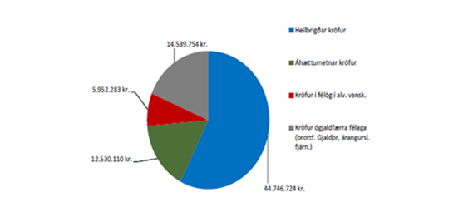
Next Steps
Most important part of the “presentation”
We need a reason to meet again
Get data samples – identify proportion of good/bad customers
Flexible pricing
Suggest Training / WorkShops for Employees
Schedule a follow up meeting if possible
Keep it Simple - Get them to start using whatever it takes (negative information)
More complicated solutions can be presented later on (application processing, scoring etc)

Slide 38
That’s All

