Slide 1
Big Data and data protection
Alastair Barter – Information Commissioner’s Office

Slide 2
The ICO - Our Mission:
The Information Commissioner’s Office (ICO) is the UK’s independent authority set up to uphold information rights in the public interest, promoting openness by public bodies and data privacy for individuals.

Slide 3
The role of the ICO
Enforce and regulate
Freedom of Information Act
Data Protection Act
Environmental Information Regulations
Privacy and Electronic Communications Regulations
Provide information to individuals and organisations
Adjudicate on complaints
Promote good practice

Slide 4
ICO Powers
£500,000 fines for serious breaches of DPA
£500,000 fines for serious breaches of PECR
Enforcement notices and undertakings
Audit functions
Criminal cases – ‘blagging’

Slide 5
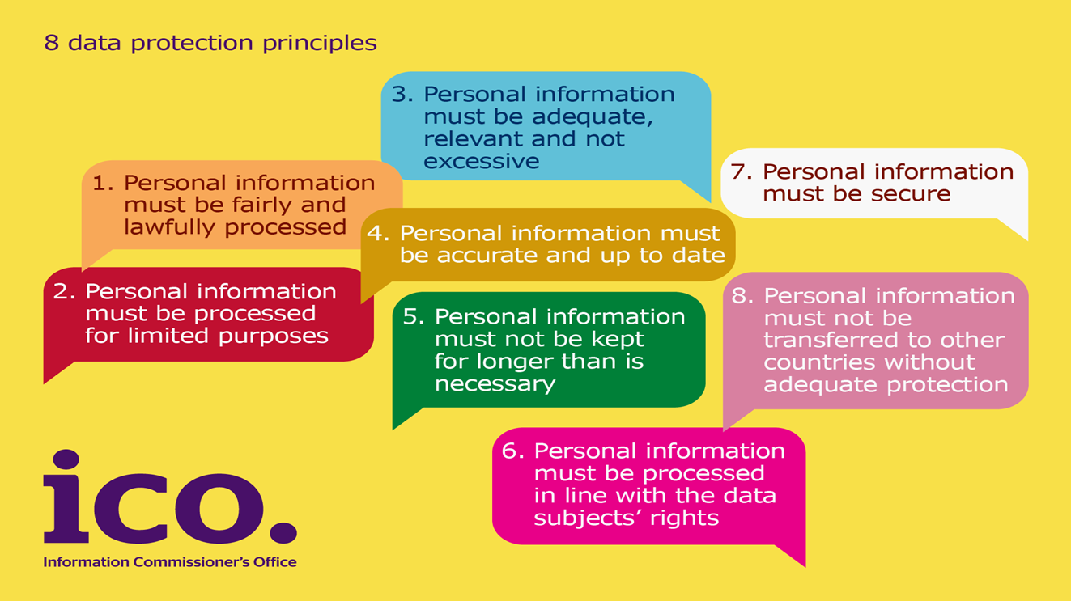
Data Protection Act 1998 The eight principles

Slide 6
Big Data - Our approach
Big data and analytics are not games played by different rules.
If personal data is used, the DP principles apply.
DP challenges organisations to be innovative in doing big data and analytics.
Be transparent; build trust.

Slide 7
Personal data
Analytics will not always use personal data
Personal data can be:
provided
observed
derived
inferred
Anonymisation does work:
can be more challenging for big data
a tool to help big data analytics

Slide 8
DP Principles
Fairness v ‘creepy’ analytics
What are people told?
What are their reasonable expectations?
What is the effect of the analysis?
Obtaining meaningful consent
Contracts, legitimate interests; is the analysis necessary?
Purpose limitation v repurposing data
Data minimisation v “n=all”
SARs –easier or harder?

Slide 9
Tools for compliance
Carry out a privacy impact assessments
Bake in privacy by design
Transparency
Privacy notices don’t work with analytics and big data?

Slide 10
DP – not fit for purpose?
Flexibility in the principles
DP challenges big data players to be innovative
Role of 3rd parties (personal data services, accreditation)
EU General Data Protection Regulation

Slide 11
Building trust, being transparent
Examples of trust-based approach; commercial drivers for this
Organisations are concerned about data quality in big data and analytics; an opportunity to build in DP
Be realistic about the benefits; be open with data subjects

Slide 12





Keep in touch
Subscribe to our e-newsletter at www.ico.org.uk
or find us on…
/iconews
@iconews

