Slide 1
Data Science and Big Data
Neil Sammut,
Business Intelligence developer,
iMovo LTd.

Slide 2
About me
I am a man of many passions, amongst which is data.
Some key points about the recent data-centric part of my life:
M.Sc. in Business Intelligence and Analytics at the University of Dundee.
Joined iMovo to work on newer BI technologies and Data Science.
“Stock Price Prediction Using Predictive Data Mining and Technical Analysis”

Slide 3



















About
iMovo is a new breed of specialist company focusing primarily in two areas:
CRM and BI/Data Science.
We are situated at the south end of Europe, operating both locally and overseas.

Slide 4







About
Business Intelligence
Customer Relationship Management

Slide 5
About questions
I love questions - they drive understanding.
However, I tend to get carried away.
We will have check-points along the presentation where we will be able to stop for a few questions.

Slide 6
About today
Today’s talk will cover two topics – Big Data and Data Science.
Both terms are currently buzz words.
The worst thing about buzz words is that everyone misunderstands them.

Slide 7
About today
Today we’ll put an end to that.
We’ll clear up both terms and discuss them a little bit.

Slide 8
So, What’s so Big about Big Data?
A foray into The new breed of analytics

Slide 9

big data n. Computing (also with capital initials) data of a very large size, typically to the extent that its manipulation and management present significant logistical challenges; (also) the branch of computing involving such data.

Slide 10
big data n. Computing (also with capital initials) data of a very large size, typically to the extent that its manipulation and management present significant logistical challenges; (also) the branch of computing involving such data.
…Who clearly know nothing about Big Data.

Slide 11
big data n. ???

Slide 12
So, What’s so big about big data?

Slide 13
What Defines Big Data?
True, size comes into the equation
If managing the data is a legitimate challenge, then it could be said
that you are dealing with Big Data.
But even then, this isn’t enough…

Slide 14
What Defines Big Data?
IBM define Big Data using the THREE Vs
V –
V –
V –

Slide 15
What Defines Big Data?
IBM define Big Data using the THREE Vs
V – Volume
V –
V –

Slide 16
What Defines Big Data?
IBM define Big Data using the THREE Vs
V – Volume
V – Variety
V –

Slide 17
What Defines Big Data?
IBM define Big Data using the THREE Vs
V – Volume
V – Variety
V – Velocity

Slide 18
What Defines Big Data?
IBM define Big Data using the THREE Vs
V – Volume
V – Variety
V – Velocity
This is getting us nearer to a good definition.

Slide 19
What Defines Big Data?
IBM define Big Data using the THREE Vs
V – Volume
V – Variety
V – Velocity
This is getting us nearer to a good definition.
A fourth V was later added (probably not by IBM) - Veracity

Slide 20
What Defines Big Data?
The FOUR Vs of Big Data
V – Volume
V – Variety
V – Velocity
V – Veracity
Now we’re getting somewhere (so the Oxford Dictionary was 25% correct).

Slide 21
Volume
Big Data is Big. REAAAAAALLY Big
Some facts:
  90% of the world’s data was created in the last THREE YEARS
  Facebook collects 500 TERABYTES every day.

Slide 22
Volume
It is safe to say that the issue of Volume is important to Big Data when:
  The size of the data is very large (the forget-using-SQL-Server kind of large)
  eBay has ~94,371,840 Gigabytes of data and counting
  And/or
  The data is growing at a very fast rate
  Twitter generates 15 Terabytes of data per day
  (All the books in the Library of Congress (USA) are 15Tb large)

Slide 23
Variety
What can we consider to be data?

Slide 24
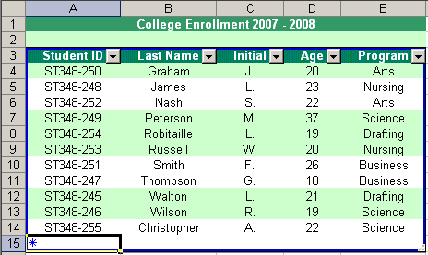
Variety
What can we consider to be data?
Ok that’s data.

Slide 25
Variety
In fact, we call it TABULAR, ATOMIC data.

Slide 26
Variety
In fact, we call it TABULAR, ATOMIC data.
TABULAR? It fits in a tabular format and can be easily interacted with.
ATOMIC? Each field is broken down to its smallest format
(like atoms in a molecule)

Slide 27
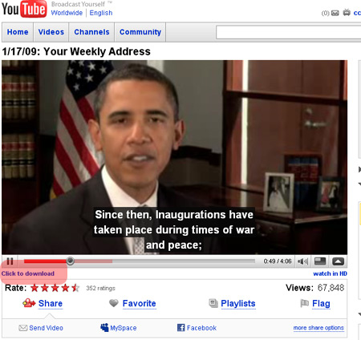
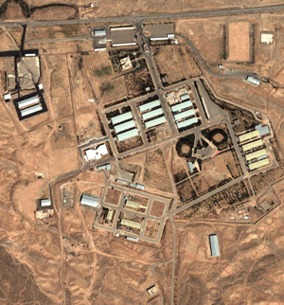
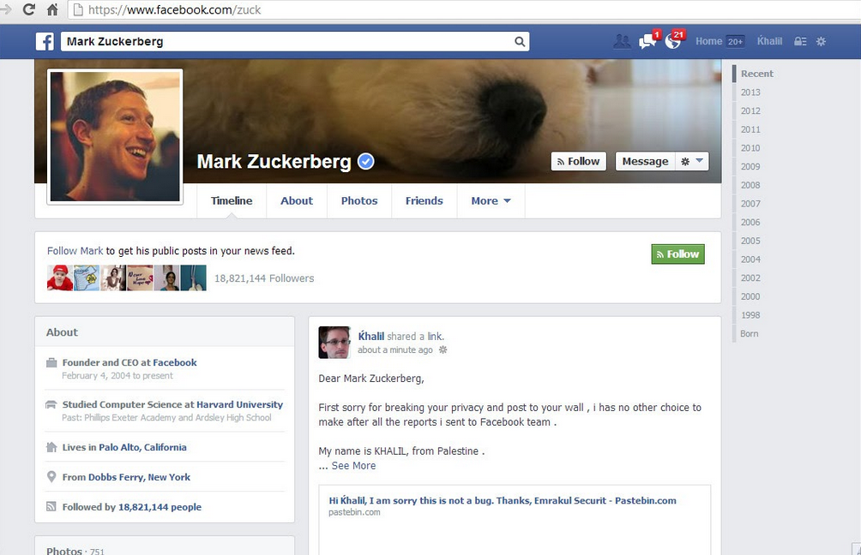

Variety
What about these?

Slide 28
Variety
We’d call that NON-TABULAR and NON-ATOMIC.

Slide 29
Variety
We used to work exclusively with data that fit neatly into tables.
One of the challenges of Big Data (non-tabular) is how to store it.
Another challenge is processing it. SQL is brilliant at working with subsets of data (ex: SELECT TOP 40 name FROM dbo.Clients) but rubbish at row-by-row comparisons (ex: processing images for information).

Slide 30
Variety
To summarise:
We can say that Big Data doesn’t always fit neatly into tables
and Big Data requires queries that are more complicated than standard ones.

Slide 31
Our Definition So Far.
Big Data is near-unmanageably large (or growing at a difficult-to-manage-with-SQL-Server rate).
Big Data won’t necessarily fit neatly into tables.
Big Data requires complex analytical queries.

Slide 32
Velocity.
Issues with Velocity in Big Data:
  The speed at which it can be collected.
  The speed at which it can be cleaned and prepared for analysis.
  The speed at which it can be processed or data-mined.
The value of Big Data grows as the speed at which it is processed and utilised does.

Slide 33
Velocity.
Issues with Velocity in Big Data:
  The speed at which it can be collected.
  The speed at which it can be cleaned and prepared for analysis.
  The speed at which it can be processed or data-mined.
The value of Big Data grows as the speed at which it is processed and utilised does.
But how fast is fast?
That depends on how quickly we need to react.
Ex: Stock Market Data vs. Social Media Data.

Slide 34
Our Definition So Far.
Big Data is near-unmanageably large (or growing at a difficult-to-manage-with-SQL-Server rate).
Big Data won’t necessarily fit neatly into tables.
Big Data requires complex analytical queries.
Big Data is only useful to us if it can be collected and processed
in an acceptably quick time. Or if our system can react to it fast enough.

Slide 35
Veracity.
Veracity deals with truthfulness.
In data terms, Veracity deals with uncertain or imprecise data.

Slide 36
Veracity.
Veracity deals with truthfulness.
In data terms, Veracity deals with uncertain or imprecise data.
Normally, Big Data is so large that we need not be concerned with
absolute accuracy.
However, Big Data must still be cleansed. And guess what?
The Velocity, Volume and Variety of Big Data make this rather difficult.

Slide 37
Veracity.
Veracity depends, then, on the application of Big Data. How accurate is “accurate enough”?
And here is a good example:
  You would mine social data from Facebook to calculate sentiment.
  But would you build a P&L Sheet in the same way?

Slide 38
Veracity.
The questions that rise are:
  How much faith can you afford to put in your data?
  How well can this data be cleansed for your needs?

Slide 39
Veracity.
Examples of situations that would require a degree of cleansing:
  Analysing blurry photos
  Fixing spelling mistakes and translating languages in Facebook data
  Reducing noise in sensor data (ex: radioastronomy)

Slide 40
Our Definition So Far.
Big Data is near-unmanageably large (or growing at a difficult-to-manage-with-SQL-Server rate).
Big Data won’t necessarily fit neatly into tables.
Big Data requires complex analytical queries.
Big Data is only useful to us if it can be collected and processed
in an acceptably quick time. Or if our system can react to it fast enough.
Big Data usually requires a degree of complex cleansing that depends
on the data’s purpose as well as its size, complexity and urgency.

Slide 41
Checkpoint (1)
our “academic” definition of Big data.

Slide 42
Examples of Big Data
With that definition ready, we can start to look at examples.
Examples of what looks like Big Data but is not:
  List of employee details, or customers, or the census.
Examples of Big Data:
  Images, Twitter feeds, RFID output, web logs, telecom data.

Slide 43
Where does Big Data come from?
Data Exhaust
New ways of collecting data at a lower cost (ex: cheaper sensors)
…In other words, Big Data can come from anywhere.

Slide 44
How to use Big Data
Big Data, like Business Intelligence, can be used to improve stuff.
It can also be used to solve problems (i.e. answer “big questions”).
Let’s look at THREE examples of how Big Data is used.

Slide 45
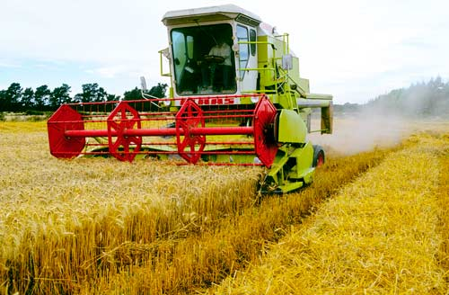
How to use Big Data
Suppose you have a Combine Harvester.

Slide 46
How to use Big Data
Suppose you have a Combine Harvester.
Sensors are becoming increasingly cheap, so it would be quite easy to cover the harvester in sensors (temperature, GPS, pressure, capacity, etc…).
This will generate some big data. Especially if all the harvesters in Europe are equipped with the same sensors.

Slide 47
How to use Big Data
Congratulations! You have just found Big Data.
But what would you use this data for?
Remember - collecting data for the sake of collecting data is not a good thing.

Slide 48
How to use Big Data
A few examples (which I copied off the internet) are:
  Finding the most economical driving style by monitoring driving habits, tracking the position of the harvester and fuel levels in the tank.
  Monitoring vibrations and temperature patterns in the parts to predict when parts might break. This could then tie into a system that automatically orders parts.
  Tracking the harvester’s position and yield, to identify the most fertile areas and those which require fertilisers.

Slide 49
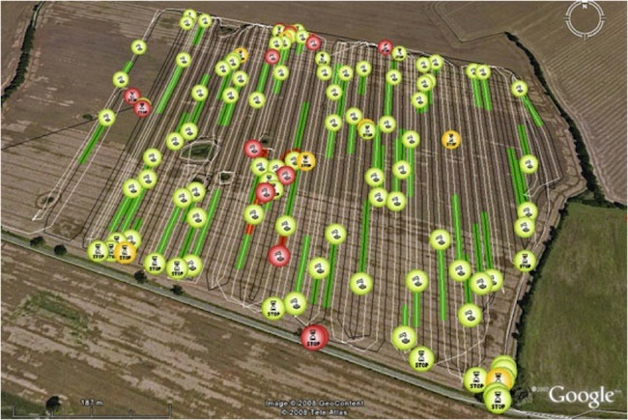
How to use Big Data

Slide 50
How to use Big Data
How did Google use Big Data?
They stored search history for every user as well as what every user clicked.
This data was needless and pointless (Data Exhaust).
What do you think that Google did with this data?

Slide 51
How to use Big Data
How did Google use Big Data?
They stored search history for every user as well as what every user clicked.
This data was needless and pointless (Data Exhaust).
Google used that data to power a spell-checker. Because if I search for “banamas” and click on something relating to “bananas”, the chances are
that I meant to search for “bananas” in the first place.
About 2 billion searches a day are made on Google.

Slide 52
How to use Big Data
LAPD use PredPol to predict crimes.

Slide 53
How to use Big Data
The LAPD mined 13 million crime reports with a specialised algorithm.
13 million arrests is 80 years’ of crime data.
They then build mission maps covering dangerous areas, and would
patrol them to minimise crime.

Slide 54
How to use Big Data
It worked. It reduced:
  Property crime by 12%
  Burglary by 26%

Slide 55
How to use Big Data
What is the point that I am trying to make?
The only things that limit Big Data are our creativity and technology.
(And the latter is changing very rapidly.)

Slide 56
Checkpoint (2)
Using Big Data.

Slide 57
Would you store Big Data?
If you think about it, once the raw data is processed it could be thrown away.
But should it?
Ideally not. Because you may want to analyse the same data in different ways.
Also, keeping historical data could help build more accurate models over time.
Example: scanning satellite photographs to build a street map and discarding the photographs afterwards will not allow me to scan again for building density.

Slide 58




Storing Big Data
Here are a few tools that can be used to store Big Data.
Having any of these does not mean that your Data Warehouse must be scrapped!

Slide 59
What is NoSQL?
It is non-tabular, and implements this non-tabularity (?) in a number of ways.
These tools excel in handling raw, unstructured and complex data.
For more information:
http://imovo.com.mt/big-data-what-happens-when-what-you-have-is-no-longer-good-enough/

Slide 60
Hadoop vs Traditional Data Warehouse
Requirement | Data Warehouse | Hadoop
Interactive Reports & OLAP | *
Exploration of raw unstructured data |  | *
Integrated, accessible archiving (online) |  | *
Cleansed & consistent data | *
Data accessibility | *
Discover unknown relationships in data | * | *
Data Mining | * | *
Governance | *
Parallel Processing on Data |  | *
Programming language compatibility |  | *
Unrestricted Sandbox Exploration |  | *
Analysis of temporary / throwaway data |  | *
Fast, tactical queries | * | *

Slide 61
The Big Data market is valued at around $16.1 billion (hardware & software).
Forbes, 2013.

Slide 62
Checkpoint (3)
Storing big data.

Slide 63
So, What’s this Data Science thing?
Blending different skills to solve new problems

Slide 64
Is Data Science a Science?
Data Science does have deep academic roots, but this does not mean that this field is confined to universities.
Lots of academics are being hired to apply scientific problem-solving to business problems. This is what gave rise to the popularity of Data Science.
Ex: A Computational Astrophysicist trying to find better ways of identifying a user’s friends in uploaded photos.

Slide 65
What is Data Science?
We can regard Data Science solving problems using the scientific method and data.

Slide 66
What problems can we solve?
The easy answer is “anything that has data”.
But hey!
The good news is that from our earlier talk about Big Data, most things nowadays are.

Slide 67
What problems can we solve?
The noble data scientist could therefore apply his skills to problems like:
Cancer Detection
User Profiling through Web Behaviour
Sales Forecasting
Optimising Airport Schedules
Weather Forecasting
Analysis of Public Sentiment
And so on, so forth…

Slide 68
So what is Data Science?
We already said that we can regard data science as using data and the scientific method to solve problems.
But how can we explain this in practical terms?
By contrasting a Data Scientist with a Business Intelligence practitioner.

Slide 69
How is Data Science different?
Let’s start by looking at the most traditional shade of Business Intelligence.
  A team sit down with meet a power user.
  Discuss what the user would like to see.
  Look at their data sources.
  Build a new data warehouse or modify the current data warehouse.
  Write packages that collect the “raw” data, transform it and store in the data warehouse.
  Design reports and dashboards to answer the questions asked in step 2.

Slide 70
How is Data Science different?
What can we understand from this? Business Intelligence aims to:
Answer known questions
Use “mainstream” methods & tools
Engineer a connection between source and data warehouse
Design reports specifically to answer known questions
Be a longer term investment.

Slide 71
How is Data Science different?
The life of a data scientist is a little different.
A data scientist (or team) is usually given a data set and given an overarching objective.

Slide 72
How is Data Science different?
For example:
  “Here is a dataset covering the past twelve months of sales for each of my coffee shops around London. Please help me find ways to improve those sales.”
This would vary from the more traditional BI objective:
  “I need to be able to see sales by region, sales by coffee type, sales by shop and sales over time.”

Slide 73
How is Data Science different?
That was an example of a real business scenario, and demonstrates the “science-y” part of Data Science.
This scenario would be resolved by:
Collecting the data into a “sandbox”
Understanding the data
Looking for patterns in data (correlations between different variables, external factors, etc…)
Classifying and/or predicting the data
Advising management with any findings.

Slide 74
How is Data Science different?
There is a strong element of discovery in this work.
Unlike Business Intelligence, a Data Scientist’s task could “fail” – there might be no patterns in data.
There might not be a correlation between weather and coffee sales, demographics and coffee sales and cost of living and coffee sales.
It is unfair to term this a “failure”, of course, because this is largely exploratory in nature.
However, this illustrates a key point – this work deals with uncertainty.

Slide 75
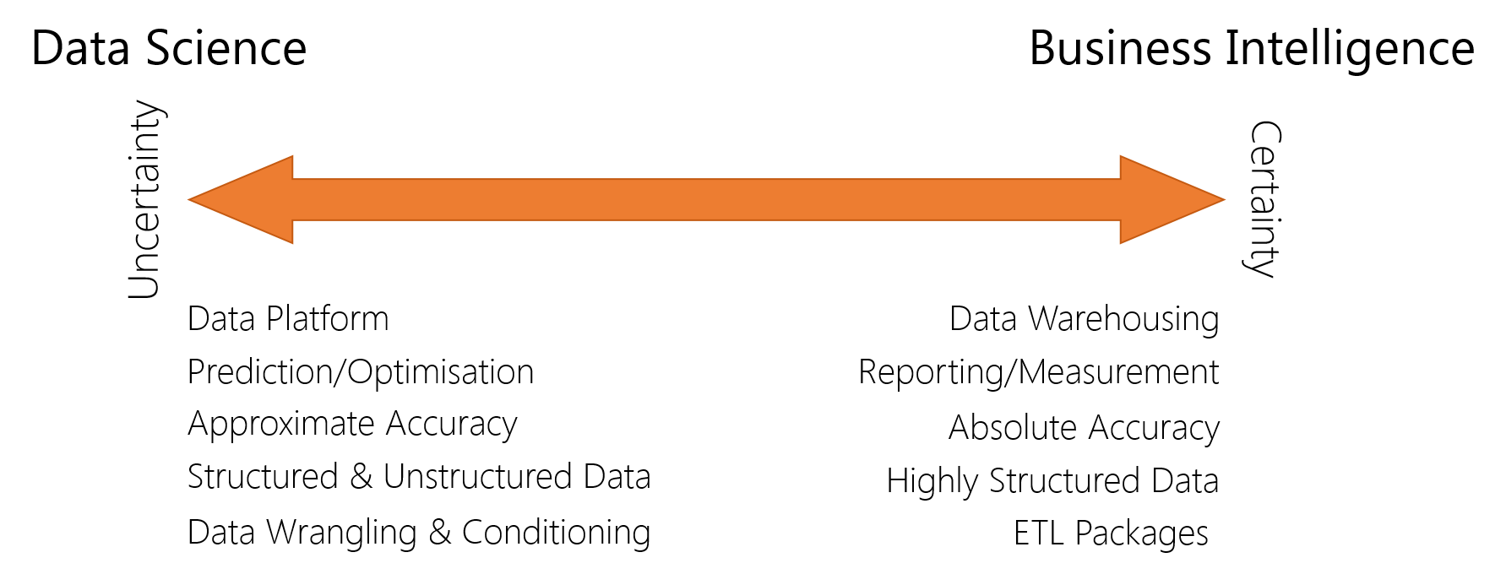
The “Spectrum of Uncertainty”

Slide 76
The “Spectrum of Uncertainty”
Sure, there are cases when the objective is a little more clear. Rather than exploring a dataset, an answer would have to be derived from known data.
For example: Here is a subset of my customers’ telephony records. How much churn should I expect?
In this case, a complex problem needs to be answered using data.
The path to solving problems like is still fraught with uncertainty. Not all methods work!

Slide 77
What techniques are usually used?
A (competent) data scientist will have to draw on a pool of skills that usually includes:
  Statistics
  Data-Handling (i.e. querying, is comfortable using databases, etc…)
  Coding (usually backend processes like data transformation)
  Machine Learning
  Critical Thinking
  Research Skills (reading academic papers, finding better ways to code things, etc…)
  Soft Skills (data scientists usually need to communicate their results to higher management)
  Curiosity (okay, this isn’t a skill but it is a key driver)

Slide 78
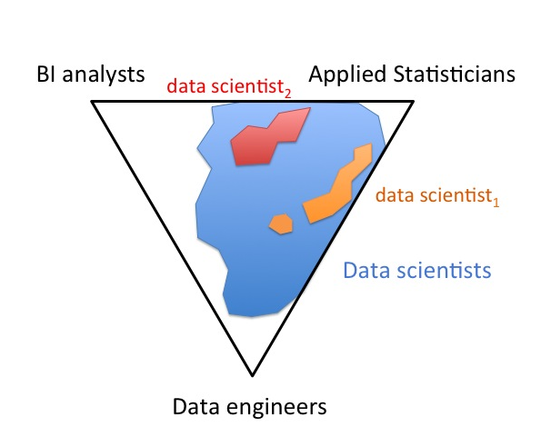
What does a Data Scientist look like?

Slide 79
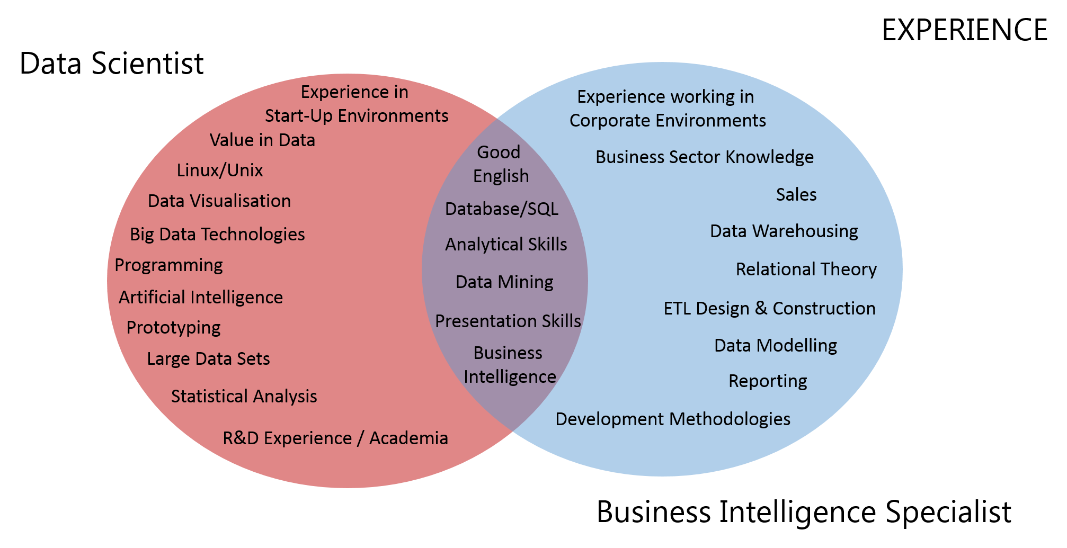
What do current employers look for?
Skills from 20 jobs.
Sources:
monster.co.uk
jobsite.co.uk

Slide 80
Will Data Science end BI?
Nope. Anyone who thinks so was probably not paying attention.
Business Intelligence is required to measure and optimise known processes. It also collects and curates data, and ensures that is stored properly.
Data Science will attempt to discover new opportunities - new things to measure. It aims to answer questions which cannot be easily answered.
They are two sides of the same coin.
Together, they will empower an organisation with hindsight and foresight.

Slide 81
Thank You
Any Questions?
You can contact me at Neil.Sammut@imovo.com.mt
Oh, and please check out
www.imovo.com.mt and www.socionomix.net

