Slide 1
Bureau Value Added Products:
Policy Rules
Smart Search
Alexander Novoselov

Slide 2
Today’s Agenda
New products in Credit Bureau:
Policy Rules Check
Smart Search
Questions anytime (preferably write it to chat)

Slide 3
Alexander Novoselov
8 years in Creditinfo Solutions (Prague, Czech Republic)
Product Owner of CBS (Credit Bureau Solution)
Bureau Sales Consultant

Slide 4
Policy Rules Check

Slide 5
What is a Policy Rule?
It is a rule used in a financial institution to check essential information on a customer while evaluating his/her application for a loan.
Example: Age Check
IF Age < 18
Than Automatic Reject

Slide 6
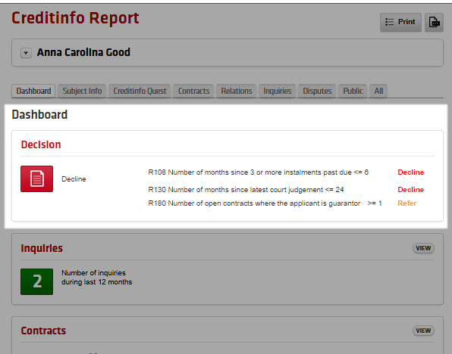
Policy Rules Check Benefits
Automatic analysis of data
Risk Alerts on critical fields
Fast Decision
Flexible setup of business rules

Slide 7
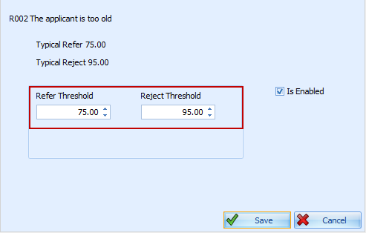
Each policy rule can be:
Enabled or Disabled
Setup a threshold for Reject and Refer (the application is sent to Underwriting)
The parameters of all business rules can be set up and changed by the Bank

Slide 8
Smart Search

Slide 9
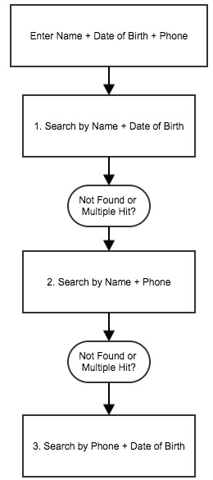
What is Smart Search?
Smart Search is a workflow of searching which helps finding subjects when no unique ID is available (e.g. Tanzania).
The module searches sequentially through a series of custom rules in order to find the most relevant hit. Examples
Name + Date of Birth
Name + Phone
Phone + Date of Birth

Slide 10
Benefits of Smart Search
Increased Hit-Rate
Custom rules for searching. E.g. Voter’s ID + Name in TZ
Building new Database from the data entered in the search
Automation of searching by usage of web-service

Slide 11
Questions?
a.novoselov@creditinfosolutions.com
Skype

